Slide 1
Tutorial 5
T03/08
Goh Rui Zhi
gohruizhi@u.nus.edu

Slide 2
Question 1
(Certificate structure) Recall that a certificate issued by a CA contains at least the following four pieces of important information:
(i) Name of an entity;
(ii) Public key;
(iii) Validity period; and
(iv) Signature.

Slide 3
Question 1
(a) For (ii), whose public key is it: the entity indicated in (i), or the CA?
Public key belongs to the entity stated in (i).
Certificate scheme is to ensure the legitimacy of entity’s public key

Slide 4
Question 1
b) Recall that the signature is computed from a key k, together with a message m.
1) Whose key k is it: the entity's public key, the entity's private key, CA's public key, or CA's private key?
k is the CA’s private key. Signature is usually done with the signer’s private key as it doesn’t make sense to sign with public key (anyone will be able to forge!).
2) Which pieces of information in (i)-(iv) are to be included in the message m?
m includes items (i) to (iii)

Slide 5
Question 2
What is a “self-signed certificate"?
A “self-signed certificate" is a certificate that is signed by the stated entity’s private key.
Stated entity refers to the entity within the certificate (Refer to item (i) in question 1)
i.e. I sign my own certificate with my private key
Who typically uses one?
It is used by a root CA.
It is also quite commonly used by developers during the early stage of software development period when a valid certificate of a relevant host is not available yet.

Slide 6
Question 3
Find out the list of certificates installed in your favoured OS, browser, and also smart phone. Did you found anything suspicious?
For Chrome: http://certificate.fyicenter.com/925_Trusted_Root_Certification_Authorities_in_Google_Chrome.html
This question is just FYI

Slide 7
Question 4
A school has a local area network that is connected to the Internet via a gateway. All incoming and outgoing traffic to the Internet therefore must go through the gateway. As part of their responsibilities to the students' parents, the school wants to inspect all the network communication made by the students, and thus have installed a monitoring agent M at the gateway.
(a) Suppose Alice is in the school. Alice often visits the webpage:
https://www.happytooth.com
to make her dental appointments. Can the monitor M find out Alice's appointment details by inspecting the traffic. Why?
(Hint: Recall that HTTPS works “on-top" of TLS/SSL, which is described in the lecture notes.)

Slide 8
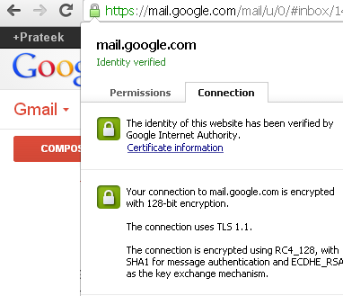
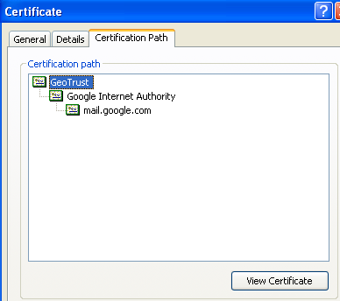
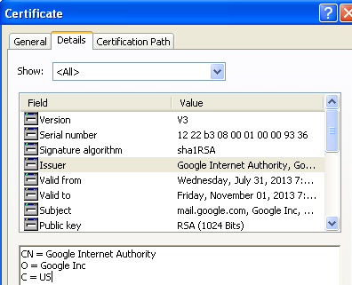
Encrypt
MAC
KE protocol

Slide 9
Question 4
(a) Can the monitor M find out Alice's appointment details by inspecting the traffic. Why?
No. Because HTTPS employs TSL/SSL to establish a secure channel between two communicating parties, where all the communicated messages are encrypted.
Note: A secure channel is a protocol that preserves data confidentiality, integrity and authentication, against a computationally bounded attacker.

Slide 10
Question 4
(b) The school insists that all network traffic via the gateway must be inspected. Hence, whenever the monitor M spots “encrypted" communication, it will drop them. Explain why this solution is not desired.
HTTPS is wide used.
Students will be unhappy if they are not able to perform day-to-day task.

Slide 11
Question 4
The students, in particular Alice, violently protest. As a compromise, the school allows the students to visit webpages using HTTPS, but with the condition that the monitor is able to decrypt and inspect the communication. The students are happy with this arrangement. The school approaches you for a solution.
Do you have something for them? How about the idea of making students' browsers forward to M any session keys that they share/establish with external sites? Is it a feasible and good solution?

Slide 12
Question 4
How about the idea of making students' browsers forward to M any session keys that they share/establish with external sites?
Will be very difficult to implement! Requires changing the way browsers interact with webpages.
Also, browsers do get updated very frequently by their developers, including for security reasons. The solution is therefore not feasible.
If we were to do the modifications, the update will remove our modifications. Then we need to start all over.

Slide 13
Question 4
(d) You search the Web, and have a better idea. The solution is as follows:
i. All students must accept a self-signed certificate with the entity name SchoolCA and its public key k_{e}. This certificate also states that SchoolCA can issue certificate, that is, it is a CA. The school and the monitor M know the private key k_{d} of k_{e}.
ii. Now, whenever a student, say Alice, wants to visit a HTTPS site, say https://www.happytooth.com, the monitor can carry out “proxy-re-encryption" to decrypt the communications, inspect, and then re-encrypt them.
Explain how the step (ii) above is to be carried out. You can use the following step-by-step guide to explain the process.

Slide 14
RECAP: Need for certificates
Want to talk to my Dentist:
Why should I trust you?
Look at my certificate
Verifies Certificate via trust model
Retrieves public key from the cert
Use this public key to create a session key via some Key Exchange protocol
Me
Dentist

Slide 15
RECAP: Need for certificates
I want to talk to my dentist. But before talking to the dentist, I want to make sure that he is who he says he is. And I do so by requesting and checking his certificate. His certificate is legitimate via certificate chaining and trust model.
Since, the certificate is legitimate, I trust that whatever is in the message of the certificate is legitimate as well. The public key of the dentist is in the message. I only want to do this check once, since its tiring to check every time before I would send a message. Therefore, I establish a shared key that makes use of the public key in the message of the certificate, through a key-exchange protocol.
I would then use this shared key for the remainder of my conversation with the dentist.

Slide 16
Question 4
Given the context in question 4, suppose Alice wants to visit https://www.happytooth.com,
M, the monitoring service, is the man-in-the-middle. What can M do?
1. M can inspect HTTPS traffic
2. M knows the private key of SchoolCA, hence, M can also issue new certificates for websites.
With this power, M will be able to see all traffic of all students by using proxy-re-encryption.

Slide 17
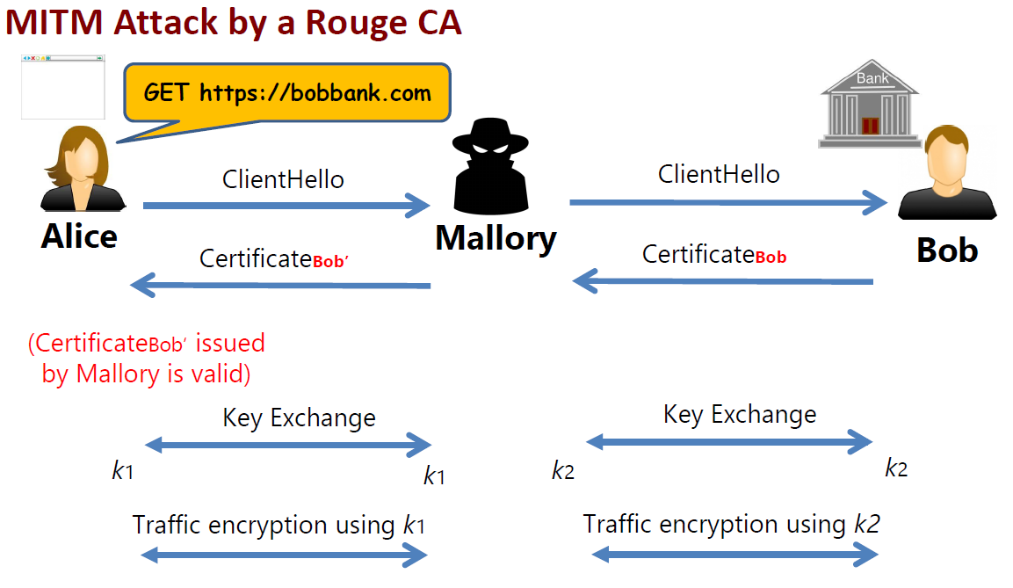
Recap: Proxy re-encryption
Certificate Bob’ contains Mallory’s public key!
Mallory does key exchange using her own keys!

Slide 18
Question 4
Step 1:
Alice authenticates Happytooth. However, M now pretends to be Happytooth and carries out the authentication as follows:
M needs to show that it knows the private key of a public key associated with identity Happytooth. To do this, M issues a certificate with
(i) Happytooth’s name as the entity, (ii) M’s public key, (iii) Validity period, (iv) Signed with private key of SchoolCA.
Step 2:
Alice will accept the information listed in the certificate issued by M, because Alice has accepted the SchoolCA’s certificate.

Slide 19
Question 4
Step 3:
After successful authentication, M and Alice establish their shared session key. Let’s call this key k₁
Step 4:
M also authenticates with Happytooth and establish their shared session key. We call this key k₂

Slide 20
Question 4
Step 5:
Now, when Alice makes her dental appointment, the message is to be encrypted using k1 and sent to M. M decrypts it using k1, inspects it, and then re-encrypts it using k2, and finally forwards it to Happytooth.
Step 6:
Same for the response from Happytooth to Alice.

Slide 21
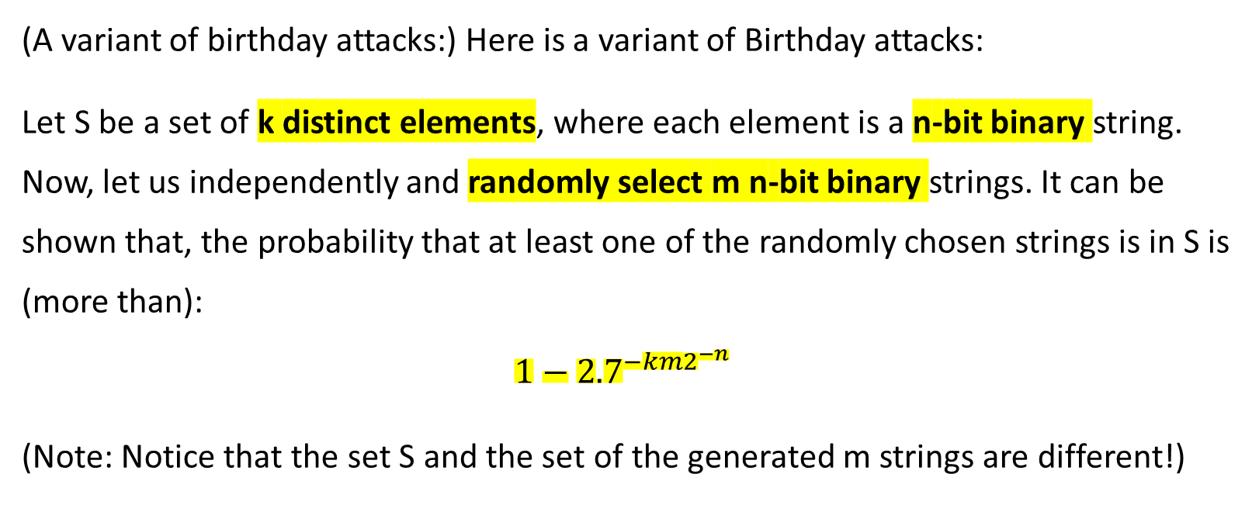
Question 5
(A variant of birthday attacks:) Here is a variant of Birthday attacks:
Let S be a set of k distinct elements, where each element is a n-bit binary string. Now, let us independently and randomly select m n-bit binary strings. It can be shown that, the probability that at least one of the randomly chosen strings is in S is (more than):
$$1−{2.7}^{−km2^{−n}}$$
(Note: Notice that the set S and the set of the generated m strings are different!)

Slide 22
Question 5
Now, consider this scenario. There are 2⁷ = 128 students in the class. Each student is assigned a secret 16-bit ID, which is known only by the student and the lecturer. The probability of correctly guessing the ID of a particular student is thus 2⁻¹⁶, which is very small. One day, the lecturer posted a multiple choice question during the lecture, and asked each student to write down the answer on a piece of paper together with his/her 16-bit ID, and insert it into a box in the lecture hall. Suppose you know the correct answer, and want to generously share it with your classmates. You quickly write down the correct answer on 32 pieces of paper, each with a randomly chosen ID, and covertly insert them into the box.
(a) What is the probability that at least one student benefits from your attempted good deed?

Slide 23

Question 5
(a) What is the probability that at least one student benefits from your attempted good deed?
Using the given formula:
n = 16, k = 2⁷, m = 2⁵
$1−{2.7}^{−2^{7}{(2}^{5})(2^{−16})}=1−{2.7}^{−2^{−4}}=0.0602$
Notes:
Exact answer: 0.0606

Slide 24

Question 5
(b) How many pieces of paper do you need to submit so that the probability is more than 0.5?
$1−{2.7}^{−\left(2^{7}\right){(2}^{−16})m}>0.5$
${2.7}^{−(2^{−9})m}<0.5$
$−2^{−9}m<\frac{\lg{0.5}}{lg2.7}$
$m> \left(\frac{−2^{9}\lg{0.5}}{lg2.7}\right)≈$ 357
Notes:
Exact Answer: 354

Slide 25

Thank you
Any questions?

